Slide 1
0% Fe
54
H₂O
Fougèrite (LDH)
c
100
Notes:
Figure 1a

Slide 2
As deposited
0% Fe
54
100
0
43
100
Post 2 h at η = 350 mV
0% Fe
54
100
0
43
100
Binding Energy (eV)
Notes:
Figure 1

Slide 3
0% Fe
14
32
54
1st cycle
2nd cycle
100
92
79
0% Fe
a
c
b
2nd cycle
Notes:
Figure 2

Slide 4
a
b
c
d
Cycle 1 (OX)
Cycle 2 (RED)
Cycle 2 (OX)
Notes:
Figure 3

Slide 5
b
Notes:
Figure 4

Slide 6
Standard
Purified
Notes:
Figure 5

Slide 7
a
29
0
100
43
b
WE 1
I_{cond}
WE 2
Notes:
Figure 6

Slide 8
Notes:
Figure 7

Slide 9
33
0 % Fe
14
92
79
54
33
54
79
100
14
92
0% Fe
100
a
b
Notes:
Figure 8

Slide 10
Deposition
18.2 MΩ●cm
0.1 M Metal salt
18.2 MΩ●cm
As Deposited
f_{i}
f_{dep}
Initial rinse
Cathodic deposition
Final rinse
Electrochemical Testing
1 M KOH
1 M KOH
1 M KOH
f_{1min}
Post 2 h at Ƞ = 350 mV
f_{0CV}
f_{120min}
f_{120CV}
CV Pre- 2 h
(η = 350 mV)
Constant Potential
CV Post- 2 h
(η = 350 mV)
a
CV Pre 2 h ( η = 350 mV)
(1st cycle)
CV Pre 2 h ( η = 350 mV)
(2nd cycle)
(OX)
(OX)
b
(RED)
c
Notes:
Figure S1

Slide 11
1st
1st cycle
1st cycle
2nd cycle
2nd cycle
0% Fe
a
33% Fe
b
Notes:
Figure S2

Slide 12
Standard
Purified
a
b
c
Notes:
Figure S3

Slide 13
a
b
WE 2
32
54
d
l
w
100
$$σ_{eff}=\frac{I_{cond}w}{NldΔV}$$
0% Fe
WE 1
c
0% Fe
d
e
100% Fe
f
Step 4
b
a
Step 1
Step 4
Step 1
Step 2
Step 3
Step 3
Step 2
Notes:
Figure S4

Slide 14
0% Fe
a
54% Fe
c
100% Fe
b
Notes:
Figure S5

Slide 15
a
Co_{0.86}Fe_{0.14}(OOH)
Co_{0.68}Fe_{0.32}(OOH)
Co_{0.46}Fe_{0.54}(OOH)
b
Co_{0.86}Fe_{0.14}(OOH)
Co_{0.68}Fe_{0.32}(OOH)
Co_{0.46}Fe_{0.54}(OOH)
c
Co_{0.21}Fe_{0.79}(OOH)
Co_{0.08}Fe_{0.92}(OOH)
Fe(OOH)
d
Co_{0.21}Fe_{0.79}(OOH)
Co_{0.08}Fe_{0.92}(OOH)
Fe(OOH)
Notes:
Figure S6
100nm (100kx) (with little square)
200nm (25kx) (little square)
1um (10kx) (bottom)

Slide 16
O1s
0% Fe
14
33
54
79
92
100
Pre-
Post-
0
15
29
43
62
77
100
Co 2p3
Binding Energy (eV)
0% Fe
14
33
54
79
92
Pre-
Post-
0
15
29
43
Fe auger
62
Fe auger
77
Fe auger
Binding Energy (eV)
Notes:
Figure S7

Slide 17
Fe 2p
14
33
54
79
92
100
Pre-
Post-
15
Co auger
29
Co auger
43
62
77
100
Binding Energy (eV)
Notes:
Figure S7

Slide 18
a
Co_{0.85}Fe_{0.15}(OOH)
Co_{0.69}Fe_{0.31}(OOH)
Co_{0.57}Fe_{0.43}(OOH)
b
Co_{0.85}Fe_{0.15}(OOH)
Co_{0.69}Fe_{0.31}(OOH)
Co_{0.57}Fe_{0.43}(OOH)
c
Co_{0.37}Fe_{0.63}(OOH)
Co_{0.23}Fe_{0.77}(OOH)
Fe(OOH)
d
Co_{0.37}Fe_{0.63}(OOH)
Co_{0.23}Fe_{0.77}(OOH)
Fe(OOH)
Notes:
Figure S8
100nm (100kx) (with little square)
200nm (25kx) (little square)
1um (10kx) (bottom)

Slide 19
CV (pre-) 1st cycle
CV (pre-) 1st cycle
CV (pre-) 1st cycle
CV (pre-) 2nd cycle
CV (pre-)2nd cycle
CV (pre-) 2nd cycle
CV (post-) 2nd cycle
0% Fe
CV (post) 2nd cycle
0% Fe
CV (post) 2nd cycle
14% Fe
CV (pre-) 1st cycle
CV (pre-) 1st cycle
CV (pre-) 2nd cycle
CV (pre-) 2nd cycle
CV (pre-) 1st cycle
CV (pre-) 2nd cycle
CV (post-) 2nd cycle
33% Fe
CV (post-) 2nd cycle
54% Fe
CV (post-) 2nd cycle
79% Fe
Notes:
Figure S9

Slide 20
CV (pre-) 1st cycle
CV (pre-) 2nd cycle
CV (pre-) 2nd cycle
CV (pre-) 1st cycle
92% Fe
CV (post-) 2nd cycle
100% Fe
CV (post-) 2nd cycle
Notes:
Figure S9

Slide 21
Cathodic
Anodic
CV (pre-) 1st cycle
1st cycle (pre- cathodic)
1st cycle (post – cathodic)
CV (pre-) 2nd cycle
2nd cycle (pre- cathodic)
CV (post 2 h in 1 M KOH) 1st cycle
14% Fe
a
2nd cycle (post – cathodic)
33% Fe
b
Notes:
Figure S10

Slide 22
Equation 1:
$${TOF}_{mass, Fe}^{app}$$
$${TOF}_{mass}=({TOF}_{Co}^{∗} ∙(1−x))+({TOF}_{Fe}^{∗}∙(x))$$
$${TOF}_{mass, Fe}^{app}= \frac{{TOF}_{mass}}{x}$$
$${TOF}_{mass, Co}^{app}= \frac{{TOF}_{mass}}{(1−x)}$$
Equation 2:
$${TOF}_{mass, Co}^{app}$$
Equation 3:
$${TOF}_{mass}$$
η = 350 mV
Notes:
Figure S11

Slide 23
Pre- 2 h at η = 350 mV
Post- 2 h at η = 350 mV
a
b
0
0
0 (S)
100
100
92
8(S)
15
14
77
63
79
31
32
43
54
Notes:
Figure S12

Slide 24
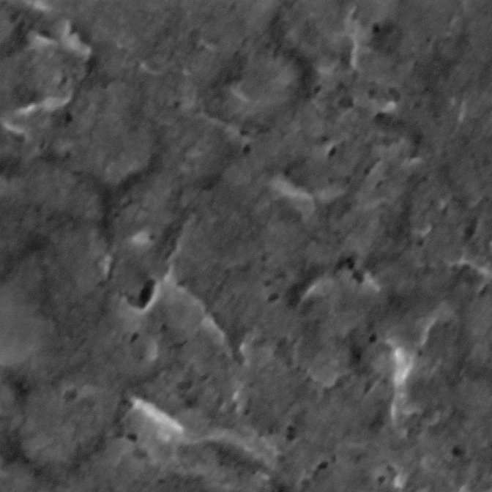
a
Fe2p
c
0% Fe
As Deposited
8 (S)
O1s
0 (P)
d
0 (P)
0 % Fe
Post-
b
79 % Fe
Fe2p
54
32
e
0 (S)
14
Post-
Notes:
Figure S13
100nm (100kx) (with little square)
200nm (25kx) (little square)
1um (10kx) (bottom)

Slide 25
a
b
c
350 mV η (0%)
300 mV η (54%)
0 % Fe
54
Notes:
Figure S14

