Slide 1
η = 450 mV
FeO_{x}H_{y}
FeO_{x}H_{y}
CoO_{x}H_{y}
CoO_{x}H_{y}
MnO_{x}H_{y}
NiO_{x}H_{y}
MnO_{x}H_{y}
Closed: Au
Open: Pt
NiO_{x}H_{y}
Notes:
wrong

Slide 2
Main Paper figures

Slide 3
Figure 1: Overpotential based TOF
A
NiO_{x}H_{y}
CoO_{x}H_{y}
Ni_{0.92}Mn_{0.08}O_{x}H_{y}
MnO_{x}H_{y}
FeO_{x}H_{y} (thick)
Co_{0.59}Fe_{0.41}O_{x}H_{y}
Ni_{0.71}Fe_{0.29}O_{x}H_{y}
Closed: Au
Open: Pt
Notes:
Co-fixed

Slide 4
Figure 1: Activity Analysis- 350
B
Insulating
Conductive
Ni_{0.71}Fe_{0.29}O_{x}H_{y}
Co_{0.59}Fe_{0.41}O_{x}H_{y}
FeO_{x}H_{y} (thin)
CoO_{x}H_{y}
FeO_{x}H_{y} (thick)
Ni_{0.92}Mn_{0.08}O_{x}H_{y}
NiO_{x}H_{y}
MnO_{x}H_{y}
Closed: Au
Open: Pt
Notes:
Fixed- Co

Slide 5
Figure 1: Activity Analysis- 450
C
FeO_{x}H_{y} (thin)
FeO_{x}H_{y} (thick)
Conductive
Insulating
CoO_{x}H_{y}
NiO_{x}H_{y}
MnO_{x}H_{y}
Closed: Au
Open: Pt
Notes:
Fixed-Co

Slide 6
Notes:
Fixed-co

Slide 7
Figure 2:
Ni_{0.92}Mn_{0.08}O_{x}H_{y}
FeO_{x}H_{y}
CoO_{x}H_{y} (1st cycle)
CoO_{x}H_{y} (2nd cycle)
MnO_{x}H_{y}
Co_{0.59}Fe_{0.41}O_{x}H_{y}
Ni_{0.71}Fe_{0.29}O_{x}H_{y}
A
NiO_{x}H_{y}
CoO_{x}H_{y}
Closed: Au
Open: Pt
Ni_{0.75}Fe_{0.25}O_{x}H_{y}
MnO_{x}H_{y}
NiO_{x}H_{y}
Co_{0.46}Fe_{0.54}O_{x}H_{y}
NiO_{x}H_{y}
MnO_{x}H_{y}
Ni_{0.92}Mn_{0.08}O_{x}H_{y}
CoO_{x}H_{y}
FeO_{x}H_{y} (thin)
Ni_{0.71}Fe_{0.29}O_{x}H_{y}
B
C
FeO_{x}H_{y} (thick)
FeO_{x}H_{y}
Co_{0.59}Fe_{0.41}O_{x}H_{y}
Notes:
Need to fix

Slide 8
Figure 3: mass % change during Tafel
CoO_{x}H_{y}
NiO_{x}H_{y}
Ni_{0.71}Fe_{0.29}O_{x}H_{y}
Stable
Unstable
MnO_{x}H_{y}
Co_{0.59}Fe_{0.41}O_{x}H_{y}
Ni_{0.92}Mn_{0.08}O_{x}H_{y}
Closed: Au
Open: Pt
FeO_{x}H_{y} (thick)
Notes:
Fixed-co

Slide 9
Supplementary information
Table S1 (see paper)

Slide 10
Figure S2
Fe contamination of Mn
XPS, Tafel and CV Pre and post
A
B
C
MnO_{x}H_{y} (Initial)
MnO_{x}H_{y}
MnO_{x}H_{y}
Mn(Fe)O_{x}H_{y} (Initial)
Intensity
Mn(Fe)O_{x}H_{y} (Final)
MnO_{x}H_{y} Final
Mn(Fe)O_{x}H_{y}
Fe 2p
Mn(Fe)O_{x}H_{y}

Slide 11
Figure S2: TOF % change with substrate
FeO_{x}H_{y} (thin)
η = 350 mV
FeO_{x}H_{y} (thick)
CoO_{x}H_{y}
NiO_{x}H_{y}
Increased activity on Au
MnO_{x}H_{y}
Co_{0.59}Fe_{0.41}O_{x}H_{y}
Ni_{0.65}Fe_{0.35}O_{x}H_{y}
Increased activity on Pt
Ni_{0.92}Mn_{0.08}O_{x}H_{y}
Notes:
Need to fix

Slide 12
Figure S3
Initial
Initial
Initial
Initial
Final
Final
Final
Final
NiO_{x}H_{y} - Au
Ni_{0.71}Fe_{0.29} O_{x}H_{y} - Au
Initial
Initial
Final
Initial
Final
Final
Initial
Final
NiO_{x}H_{y} - Pt
Ni_{0.65}Fe_{0.35} O_{x}H_{y} - Pt

Slide 13
Figure S3
Initial
Initial
Initial
Final
Final
Initial
Final
MnO_{x}H_{y} - Au
Final
Ni_{0.92}Mn_{0.08}O_{x}H_{y} - Au
Initial
Initial
Initial
Initial
Final
Final
Final
MnO_{x}H_{y} - Pt
Final
Ni_{0.92}Mn_{0.08}O_{x}H_{y} - Pt

Slide 14
Figure S3
Initial
Final
Final
Initial
Final
Initial
Final
Initial
CoO_{x}H_{y} -Au
Co_{0.59}Fe_{0.41}O_{x}H_{y} - Au
Initial
Initial
Initial
Initial
Final
Final
Final
Final
Co_{0.56}Fe_{0.44}O_{x}H_{y} - Pt
CoO_{x}H_{y} -Pt

Slide 15
Figure S4
Anodization at η = 450 mV
Anodization at η = 450 mV
A
Thin initial
B
Thick initial
Thick initial
Thick final
Thin final
Thick final
Thin initial
Au substrate
Pt substrate
Thin final

Slide 16
Figure S5
Thick Fe
As Deposited (11.9 µg cm⁻²)
1 µm
100 nm
100 nm
Post 3 min at η = 450 mV (initial 11.0 µg cm⁻²)

Slide 17
Figure S5
Thin Film Fe
As Deposited (2.2 µg cm⁻²)
Post 3 min at η = 450 mV (initial 1.4 µg cm⁻²)

Slide 18
Figure S6
NiO_{x}H_{y}
CoO_{x}H_{y}
Pt
Au
Pt
Pt
Au
Pt
Au
Au
Ni_{0.71}Fe_{0.29} O_{x}H_{y}
Co_{0.59}Fe_{0.41}O_{x}H_{y}
Au
Pt
Au
Pt
Pt
Pt
Au
Au
Notes:
Fixed-co

Slide 19
Figure S6
MnO_{x}H_{y}
Ni_{0.92}Mn_{0.08}O_{x}H_{y}
Au
Pt
Pt
Pt
Au
Au
Pt
Au

Slide 20
Figure S7
SEM-POST
MnO_{x}H_{y} - Au
1 µm
100 nm
100 nm
MnO_{x}H_{y} - Pt
Notes:
5kx: 1um
50kx:100nm
100kx:100nm
(change size to 3in height and then crop to 2x2in)
Mn (Au) : 4p32
Mn (Pt) : 4p69
NiMn (Au): LJE NiMnon Au
NiMn (Pt): LJE NiMnon PT

Slide 21
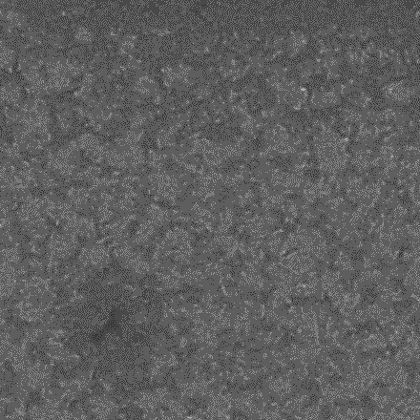
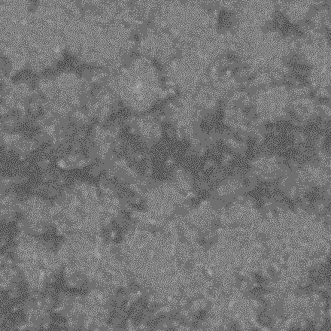
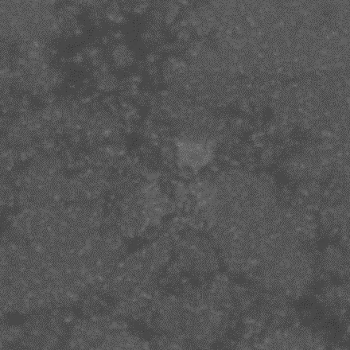
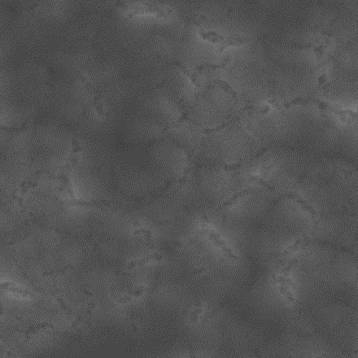
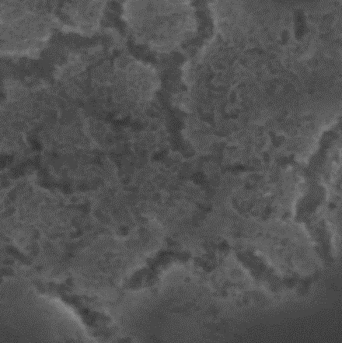
Figure S7
SEM-POST
Ni_{0.92}Mn_{0.08}O_{x}H_{y} - Au
Ni_{0.92}Mn_{0.08}O_{x}H_{y} - Pt
Notes:
5kx: 1um
50kx:100nm
100kx:100nm
(change size to 3in height and then crop to 2x2in)
Mn (Au) : 4p32
Mn (Pt) : 4p69

Slide 22
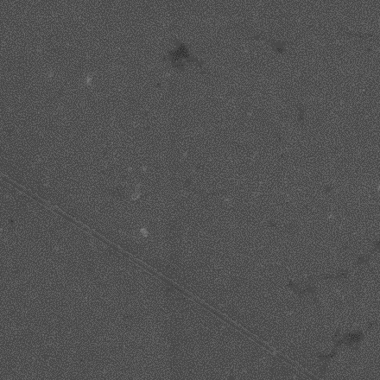
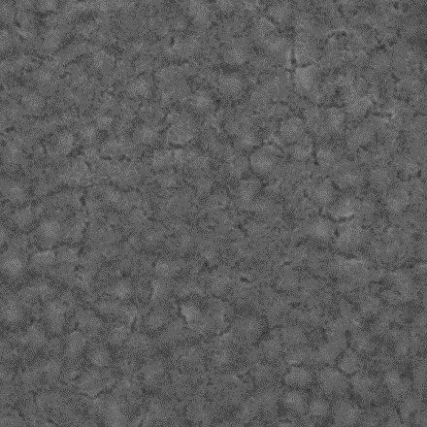
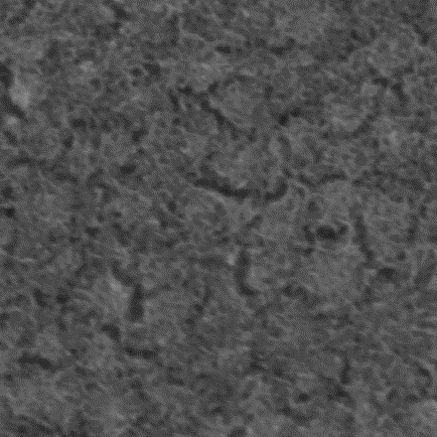
Figure S7
SEM-POST
NiO_{x}H_{y} - Au
NiO_{x}H_{y} - Pt
Notes:
5kx: 1um
50kx:100nm
100kx:100nm
(change size to 3in height and then crop to 2x2in)
Mn (Au) : 4p32
Mn (Pt) : 4p69

Slide 23
Figure S7
SEM-POST
Ni_{0.71}Fe_{0.29} O_{x}H_{y} - Au
Ni_{0.65}Fe_{0.35} O_{x}H_{y} - Pt
Notes:
5kx: 1um
50kx:100nm
100kx:100nm
(change size to 3in height and then crop to 2x2in)
Mn (Au) : 4p32
Mn (Pt) : 4p69

Slide 24
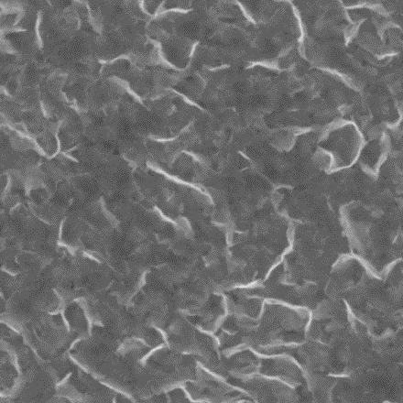
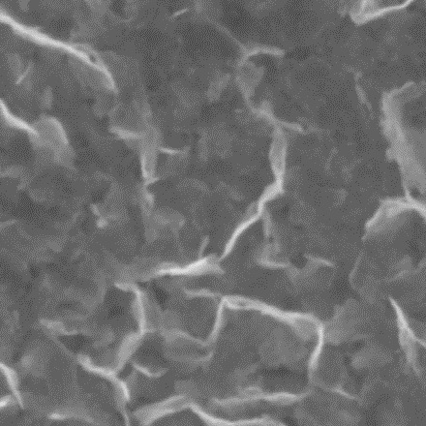
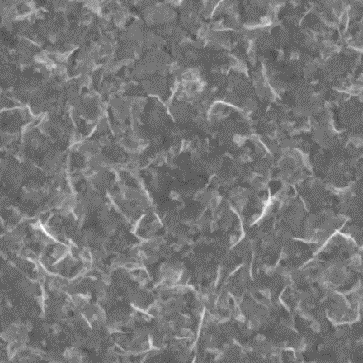
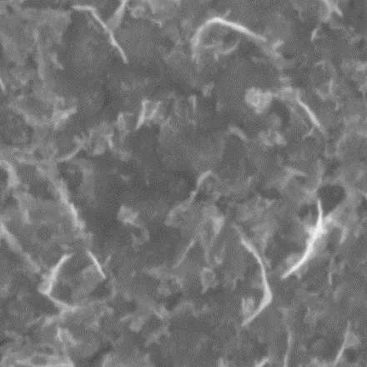
Figure S7
SEM-POST
CoO_{x}H_{y} - Au
CoO_{x}H_{y} - Pt
Notes:
5kx: 1um
50kx:100nm
100kx:100nm
(change size to 3in height and then crop to 2x2in)
Mn (Au) : 4p32
Mn (Pt) : 4p69

Slide 25
Figure S7
SEM-POST
Co_{0.59}Fe_{0.41}O_{x}H_{y} - Au
Co_{0.56}Fe_{0.44}O_{x}H_{y} - Pt
Notes:
5kx: 1um
50kx:100nm
100kx:100nm
(change size to 3in height and then crop to 2x2in)
Mn (Au) : 4p32
Mn (Pt) : 4p69

Slide 26
Figure Si:8
Fe 2p
Fe 2p
Ni_{0.92}Mn_{0.08}O_{x}H_{y} - Pt
Mn Auger
MnO_{x}H_{y} – Au (Al Kα)
NiO_{x}H_{y} control - Au
Fe 2p
Ni_{0.71}Fe_{0.29} O_{x}H_{y} - Au
Fe 2p
NiO_{x}H_{y} - Au
Ni_{0.65}Fe_{0.35} O_{x}H_{y} - Pt
NiO_{x}H_{y} - Pt

Slide 27
Figure Si:8
Fe 2p
Co_{0.56}Fe_{0.44}O_{x}H_{y} - Pt
Fe 2p
CoO_{x}H_{y} - Pt
Co_{0.59}Fe_{0.41}O_{x}H_{y} - Au
CoO_{x}H_{y} - Au

