Slide 1
Fig. 1
Immediate and Cycling
0
Ni_{1-z} Fe_{z}O_{x}H_{y}
11
1 mM
Fe(NO₃)₃
z (%) =
16
21
24
Cycle #
A
z (%) =
0 %
11 %
16 %
21 %
24 %
e⁻ per Ni
1 mM Fe(NO₃)₃
B
E_{pa}
C
Overpotential
Notes:
Fixed – this is 4p235 data (Fe-spiked)
Talk about similar loading...

Slide 2
Figure 2
Ni-Fe conductivity
Pre- Fe
(1)
(2)
(3)
1 mM
Fe(NO₃)₃

Slide 3
Fig. 3 Co-dep vs spiking
10 %
0%
8 %
25%
30 %
0%
Fe (%) $=$
Fe (%) $=$
Co-deposited
A
Spike
B
Spike
Co-deposited
C
Open = co-deposited
D
Open = co-deposited
Closed = spiked
Closed = spiked

Slide 4
Supplementary Information

Slide 5
Figure S1
NiO_{x}H_{y}
CV 4
CV 5-104
A
e⁻ per Ni
B
E_{pa}
C
Ni 2p
Fe 2p
D
E

Slide 6
Figure S2
Ni_{1-z}Fe_{z}O_{x}H_{y}
Ni_{1-z}Fe_{z}O_{x}H_{y}
0 %
Anodic
4
CV =
5
14
34
104
2nd peak
A
1 mM Fe(NO₃)₃
C
0 %
Cathodic
Anodic
1 mM Fe(NO₃)₃
Cathodic
2nd peak
B
D

Slide 7
Figure S3
Get Ni-only conductivity here….
NiO_{x}H_{y}
(1)
(2)
(3)

Slide 8
Figure S4
Fe-spiked on Ni w/Au and Pt substrate
1 mM Fe(NO₃)₃
Au
NiO_{x}H_{y}
NiO_{x}H_{y}
1 mM Fe(NO₃)₃
Pt
NiO_{x}H_{y}
NiO_{x}H_{y}
Fe-Free
base
Au
Pt
Fe-Free
base
A
B
ROLE of substrate

Slide 9
Figure S5
SEM
A
B
C
D

Slide 10
Ni
Ni
Fe
Ni
Fe
Ni
Fe

Slide 11
Ni
Ni
Fe
Ni
Fe
Ni
Fe

Slide 12
Figure
XPS vs ICP composition
Open = co-deposited
Closed = spiked
Notes:
Change for Ni that was cycled differently.... Could you say that the Fe is not evenly distributed with this data?

Slide 13
Ni
Fe
Ni
Fe
Ni
Notes:
Change for Ni that was cycled differently.... Could you say that the Fe is not evenly distributed with this data?

Slide 14
Figure
XPS/ICP
Ni 2p
Fe 2p
Co-dep
Fe spike
25 %
25 %
100 CV
20 %
10 CV
20 %
10 %
10 %
2 CV
6 %
A
0 %
6 %
composition
Notes:
Remove the 0% from old one and add new...need to change out 10 CV and add 30 CV as well and Co-dep Ni99Fe01 – add co-dep for different compositions? Add zero – figure out why Fe peaks appear to be shifting...

Slide 15
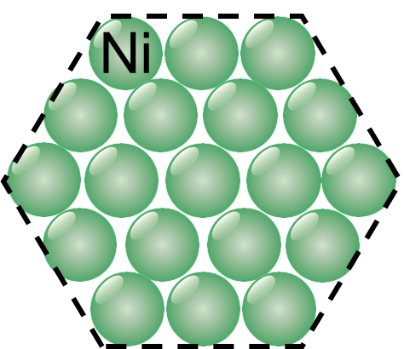
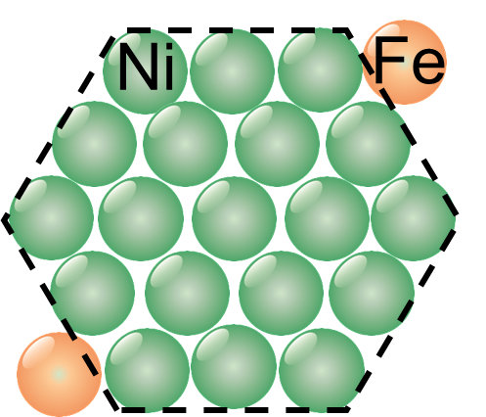
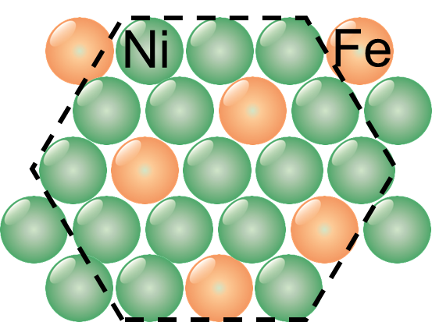
Fe³⁺ added to electrolyte
NiO_{x}H_{y}
Fe-free
edge/defect
bulk
Notes:
3.25 by 1.75

